Slide 1


Designing a Modular Currency Converter for GlobalPay Financial Services

Slide 2

GlobalPay Scenario Overview
GlobalPay Financial Services helps small businesses process secure international payments efficiently.
This project builds a modular currency converter reflecting professional fintech standards.
The program converts U.S. dollars into Euros or Mexican Pesos using fixed rates.
It demonstrates structured coding, localization, and reliable error handling used in financial systems.

Slide 3
Code Structure and Organization
The application uses Java’s module system with module name globalpay.converter.
The main class CurrencyConverter is inside the package globalpay.converter.
Exchange rates are defined as constants for easy maintenance.
The structure promotes readability, scalability, and professional organization.

Slide 4
Step-by-Step Program Flow
The program loads messages using ResourceBundle with Locale.US.
It displays a welcome message and prompts for a USD amount.
The user selects EUR or MXN, and the switch statement applies the correct rate.
The result is formatted to two decimal places before display.

Slide 5
Exception Handling (try/catch)
All input logic is placed inside a try block for safe execution.
Non-numeric input triggers NumberFormatException and displays a friendly message.
Unsupported currency codes trigger IllegalArgumentException.
The finally block ensures a thank-you message always appears.

Slide 6
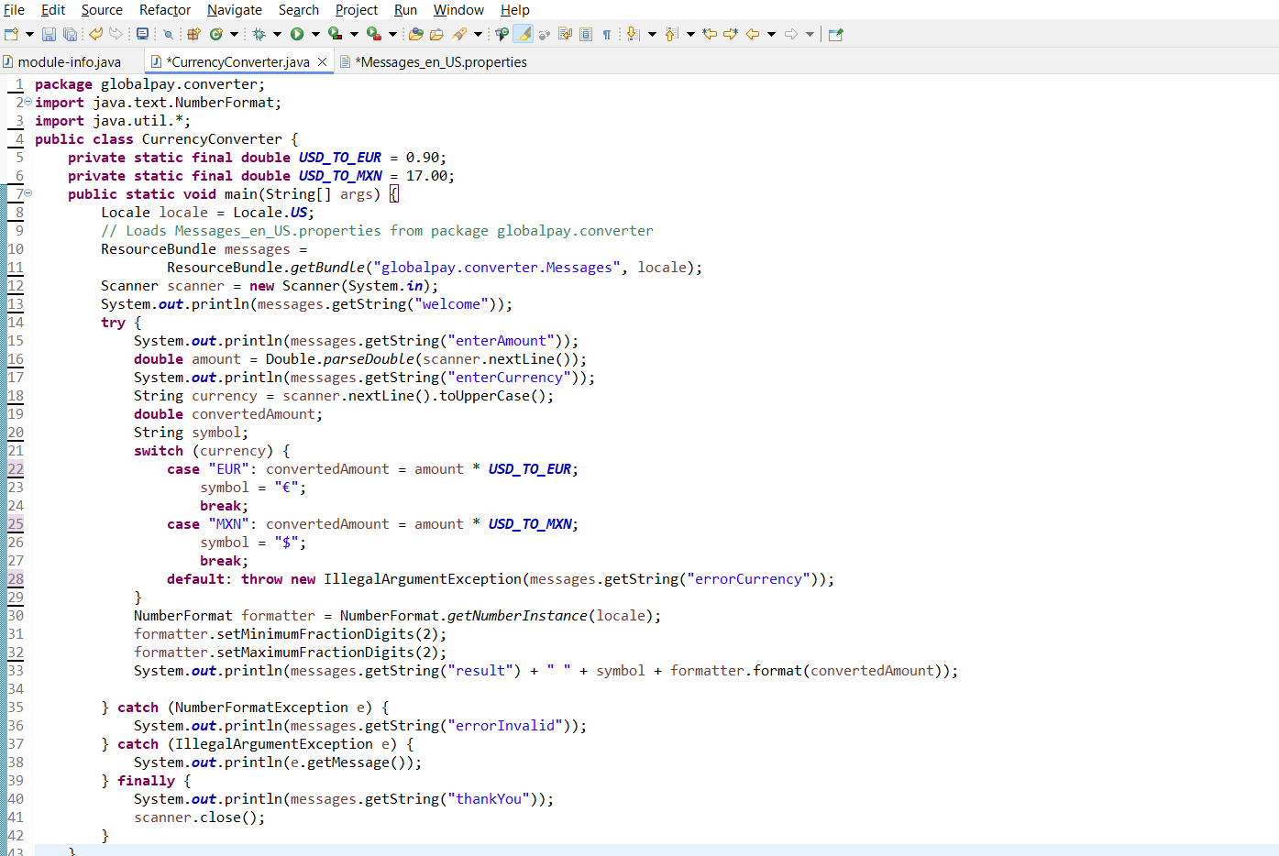

Slide 7
Messages_en_US.properties File
The properties file stores all user-facing text separately from code.
Messages are written as key-value pairs for easy retrieval.
ResourceBundle loads messages dynamically based on locale.
This design supports updates and future multilingual expansion.

Slide 8
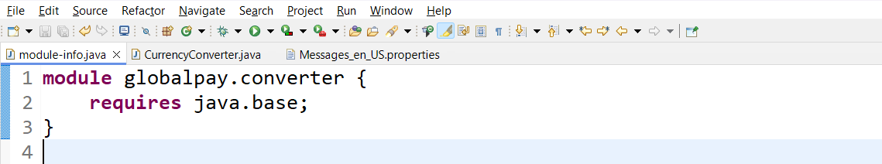
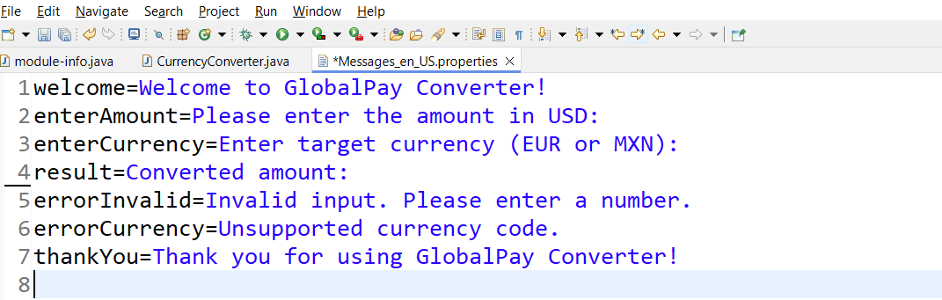

Slide 9
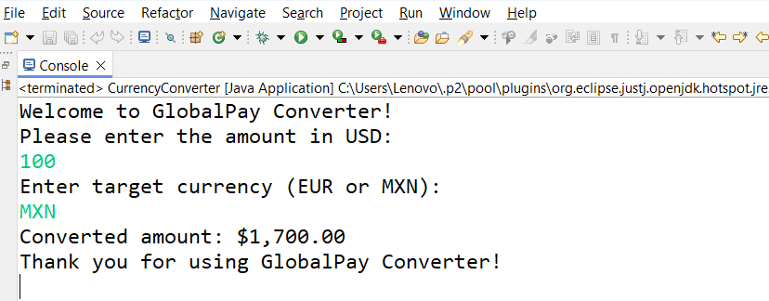
OUTPUT OF THE CODE

Slide 10
Program Demonstration
Valid input example: 100 USD to EUR displays €90.00.
The output confirms accurate calculation and formatting.
Invalid input like 'abc' is safely caught.
The program displays a clear error without crashing.

Slide 11
Importance in Financial Software
Clear error messages improve user trust and reduce confusion.
Exception handling prevents crashes during financial transactions.
Modular design enables scalable and maintainable systems.
GlobalPay’s converter reflects professional fintech development practices.

Slide 12
THANK YOU

